Slide 1





Car2know

Slide 2
Car2know
No more or know more,
that is the question.

Slide 3
Motivation
Emerging Uber, Lyft and Car2Go have become important means of transportation in our daily life. Our group want to analyze the Car2Go flux based on the census blocks in Seattle and visualize it on the map. It will provide insight into the supply and demand for the customers, car rental companies, as well as city planners and business analysts.

Slide 4
Raw Data
Dataset 1: Car2Go API Query (txt file)
Contains info on time, location, car id, fuel level
Dataset 2: Seattle Census Block Map(ArcGIS format)
Contains multiple file types such as shp, dbf, sbn, shx, sbx …

Slide 5
Workflow and key issues
get_car2go_data()
Car2Go API query
calc_trip()
single location -> orig/dest pairs
get_block_id() or get_grid_id()
each orig/dest -> block/grid id. Block info only available in ArcGIS, while grid id can be computed manually
calc_flux()
histograming all in Python
map_flux()
In ArcGIS or Python, or both?

Slide 6
Urllib2 Package

Slide 7
Background
The urllib2 module defines functions and classes which help in opening URLs (mostly HTTP) from car2go’s api
Using Request, urlopen function to fetch data
Storing the data in a txt file named the data’s date

Slide 8
Using urllib2
urllib2.Request:
request = Request("http://www.car2go.com/api/v2.1/vehicles?loc=" + city + "&oauth_consumer_key=" key "&format=json")
urllib2.urlopen:
response = urlopen(request)
return response.read()

Slide 9
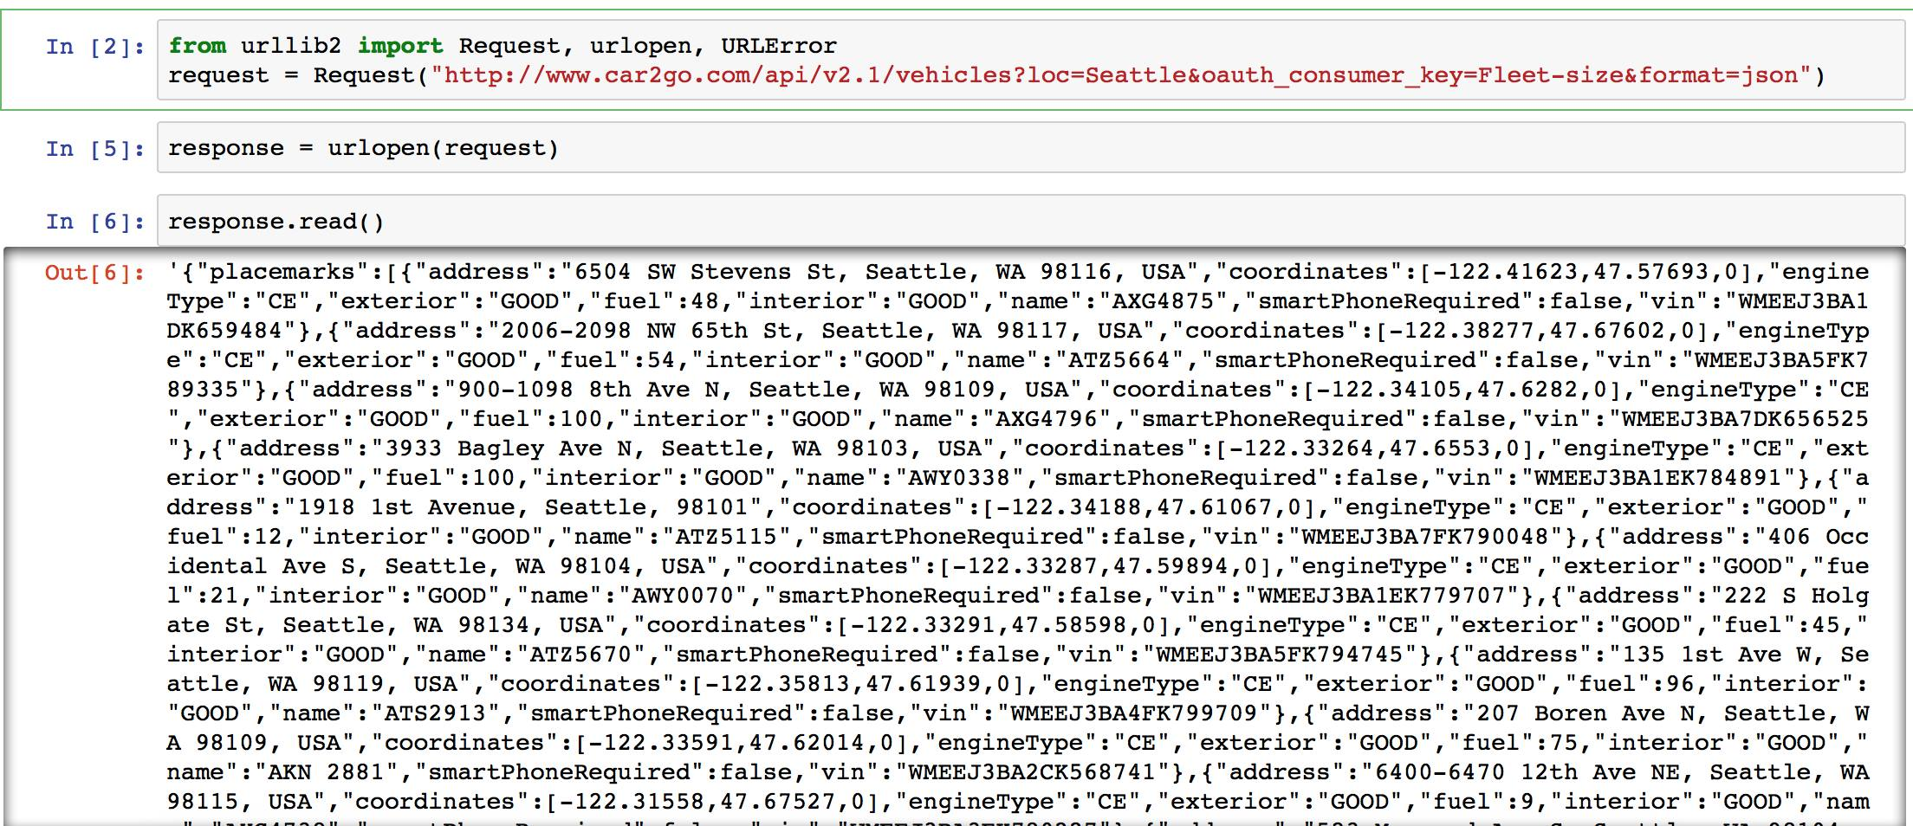
request results

Slide 10
Assessment of urllib2
Appeal
--Very easy to use and store the data
--Could request with high frequency: twice per minute
Drawbacks
--Have to run all the time to request the data

Slide 11
Arcpy Package

Slide 12
Background
Need access to ArcGIS data
Perform geographic data analysis, data conversion and map automation

Slide 13
Using ArcGIS/Arcpy
Import Car2Go data into ArcMap:
Transform the projection system into ‘GSC North American 1983’
Clip the map size to a proper range

Slide 14
Using ArcGIS/Arcpy
2. Merge the Car2Go dataset with the Census Block:
Intersect 2 datasets
Distribute the cars to the blocks

Slide 15
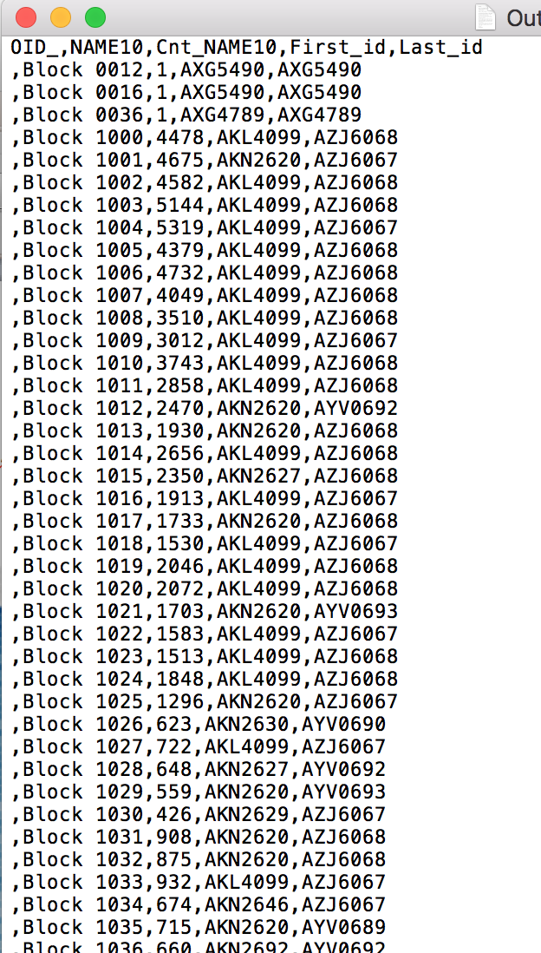
Using ArcGIS/Arcpy
3. Analyze the data:
Count the cars in per block
Get the influx and outflux
Output the data

Slide 16
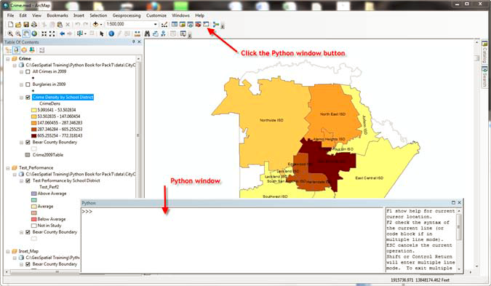
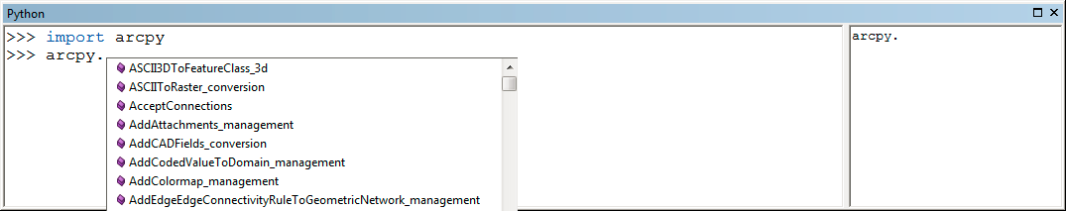
How Arcpy works

Slide 17
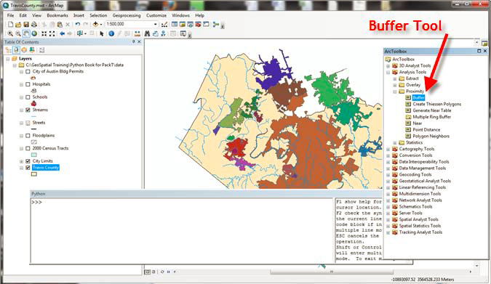
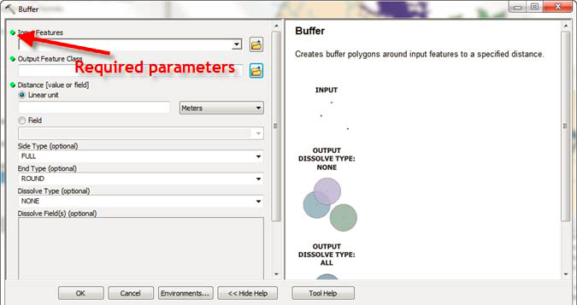
How Arcpy works

Slide 18
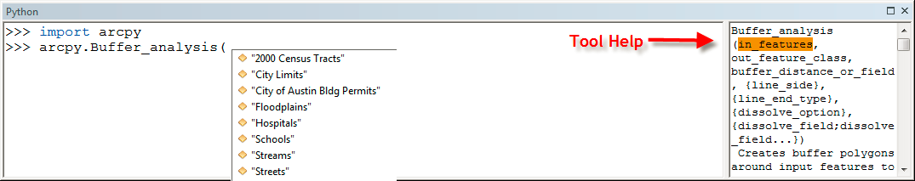
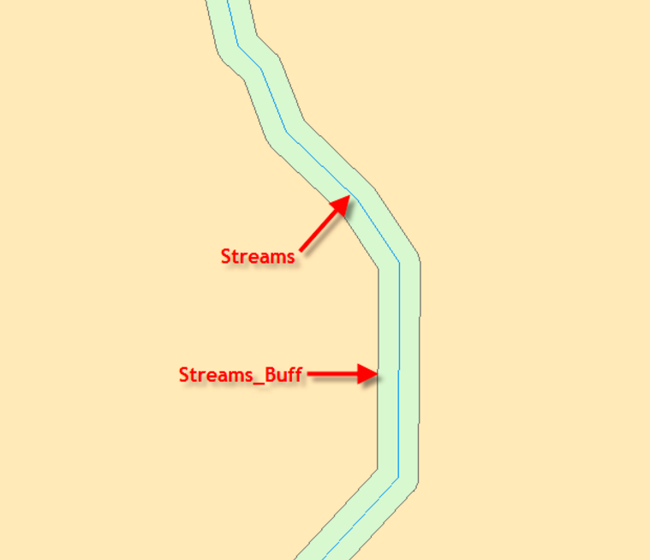
How Arcpy works

Slide 19
Assessment of Arcpy
Appeal
--strong spatial analysis ability
--good visualization of each step
Drawbacks
--the code is complicated (many setting values)
--has to be performed in ArcMap

Slide 20
matplotlib basemap toolkit
Appeal
a library for plotting 2D data on maps in Python
transform coordinates to map projections
read shapefile attribute format (.dbf) file
Drawbacks
how to load ArcGIS data

Slide 21
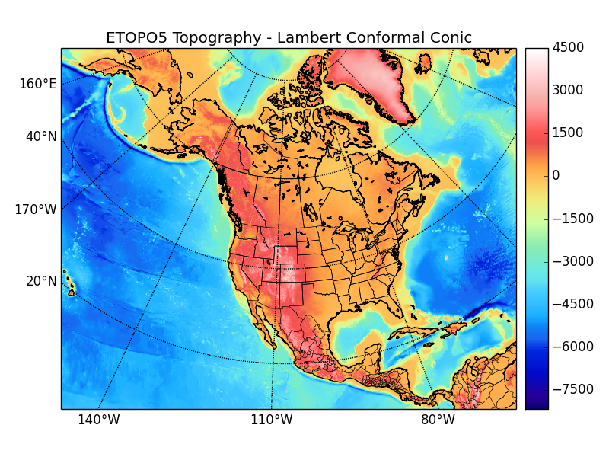
matplotlib basemap toolkit
from mpl_toolkits.basemap import Basemap
…..
arcgisimage(server='url', service=' ', xpixels=400, ypixels=None, dpi=96, verbose=False, **kwargs)
Retrieve an image using the ArcGIS Server REST API and display it on the map.

Slide 22
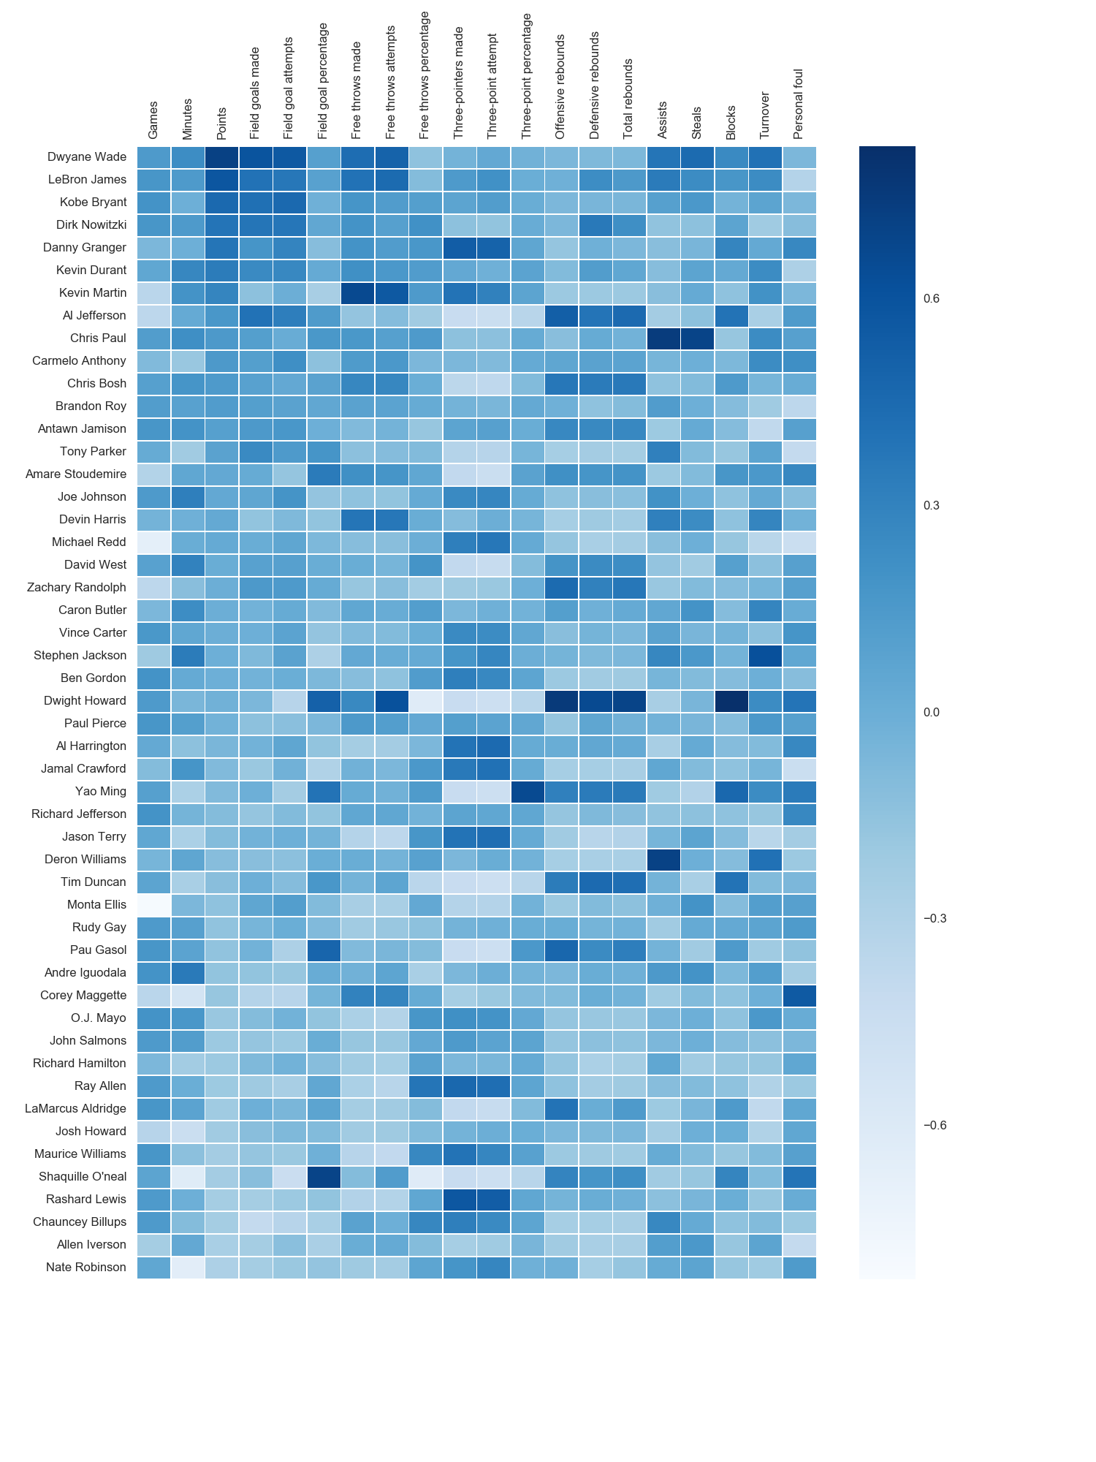
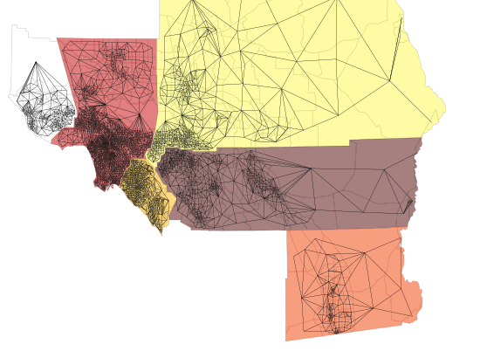
PySAL
import pysal
spatial analysis functions
Spatial Weights
Spatial Autocorrelation

